Slide 1
.NET Today and Tomorrow
Michael Reynolds mreynolds1@gmail.com

Slide 2














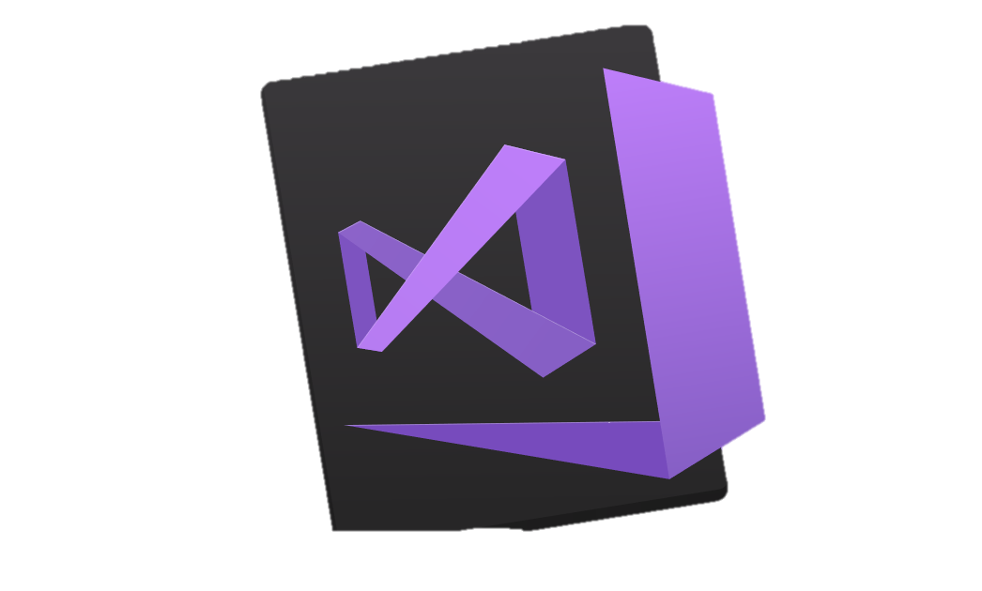
Your platform for building anything
DESKTOP
WEB
CLOUD
MOBILE
GAMING
IoT
AI
.NET
Visual Studio
Visual Studio for Mac
Visual Studio Code
Command Line
Your editor
Notes:
You can build anything with .NET. We’ve made significant investments in .NET over the years as well as unifying the ecosystem to support building literally anything. From desktop to gaming to the cloud, .NET is a general purpose programming platform that enables all kinds of scenarios. Once you learn one, you can easily pick up another.
<CLICK>
What’s more, you can also use your favorite tools and editors to build .NET apps – or use Visual Studio, Visual Studio Code or Visual Studio for Mac.

Slide 3






RayGun
"Using the same-size server, we were able to go from 1,000 requests per second per node with Node.js to 20,000 requests per second with .NET Core."
- John-Daniel Trask, CEO and Co-Founder
AstroReality, Quantum Technologies
"We think .NET Core is mature, very powerful, and a great choice for advanced modern apps."
- Zerlot Ma, Cofounder and CEO
Jet.com Inc.
"The event-driven, microservices paradigm eliminated a lot of the overhead that comes with a service-oriented architecture."
- Mike Hanrahan, CTO
Tencent
“The cross-platform capabilities of .NET Core were very important to us. Also, Microsoft designed .NET Core with a microservice architecture in mind, and that fits right in with our redesign plans.”
- Shanyou Zhang: Senior Software Architect
Age of Ascent, Illyriad Games
"Our game microservices are built using ASP.NET Core which gives us superior performance. ASP.NET is open source, that allows us to contribute back to it if we have any performance issues which Microsoft review and together we make a better product."
- Ben Adams, CTO and Co-founder
NetEase
".NET Core doesn't just help us get to market faster, it also enables our developers to focus on the core logic and what really matters, our players' experience. They don't have to deal with the communication gap and different ways of implementing the algorithm on the back and front end. They can just work on finding better ways to implement their ideas."
- Feng Zhou, Product Director
United Parcel Service (UPS)
"Xamarin allowed us to develop a single code base in C# and deploy the application to two completely different mobile phone ecosystems."
- Scott Hildebrand, Application Development Manager
GoDaddy
“Services can be developed more quickly, perform faster in production, and scale better if they’re written using .NET Core with C#.”
- Jeremiah Gowdy: Principal Software Architect
And many more: microsoft.com/net/customers
Notes:
Our customers have been embracing the productivity in our platform, languages and tools for 15+ years. We’re now gaining existing customers as well as new ones on our cloud-native, cross-platform, and device-native approaches with these new architectures. Here are just a few. There are many more (and their stories) on our website.

Slide 4
.NET Open Source & Cross-Platform
750K
+1M
.NET Core developers
New .NET developers
in last year
Notes:
We’re seeing incredible growth in .NET.

Slide 5

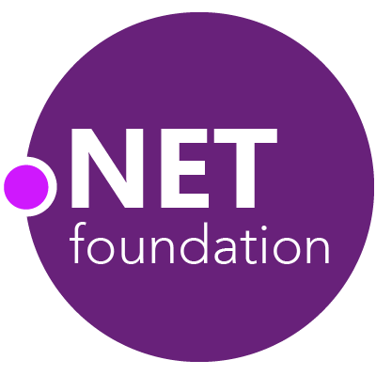
Steeltoe
.NET Core
Microsoft Web Protection Library
MSBuild
DotNetNuke
ASP.NET AJAX Control Toolkit
ASP.NET Core
SourceLink
Microsoft Azure WebJobs SDK
Salesforce Toolkits for .NET
nUnit
MVVM Light Toolkit
IronPython
Mailkit
WorldWide Telescope
Nancy
Open XML SDK
.NET SDK for Hadoop
MvvmCross
MEF
JSON.NET
Mimekit
xUnit
ASP.NET Web Pages
NuGet
IdentityManager
Couchbase Lite for .NET
ML.NET
iOS
macOS
MiniProfiler
Entity Framework
.NET ECOSYSTEM
WCF
ILMerge
Xamarin.Mobile
ASP.NET SignalR
Infer.NET
.NET Micro Framework
StackExchange.Redis
Mono
protobuf-net
Open Live Writer
Xamarin.Auth
Xamarin SDK
Orchard CMS
OWIN Authentication Middleware
ProtoBuild
IdentityServer
Microsoft Azure SDK for .NET
.NET Compiler Platform ("Roslyn")
Prism
ASP.NET Web API
Cake
Orleans
Kudu
Cecil
LLILC
Umbraco
System.Drawing
ASP.NET MVC
Notes:
The .NET Foundation is our center of gravity for open development and collaboration around the .NET ecosystem. The .NET Foundation has over 50 projects and hundreds of repos under its stewardship. Open Source Software foundations provide protection, support, services and best practices for helping each project be successful and to grow the ecosystem of people and software.

Slide 6
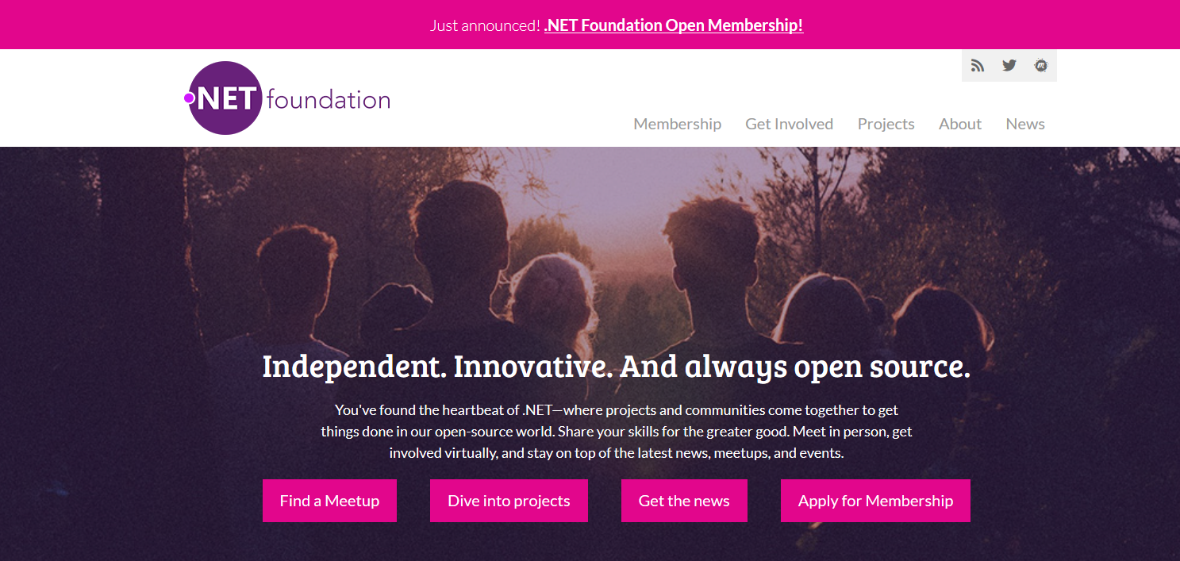
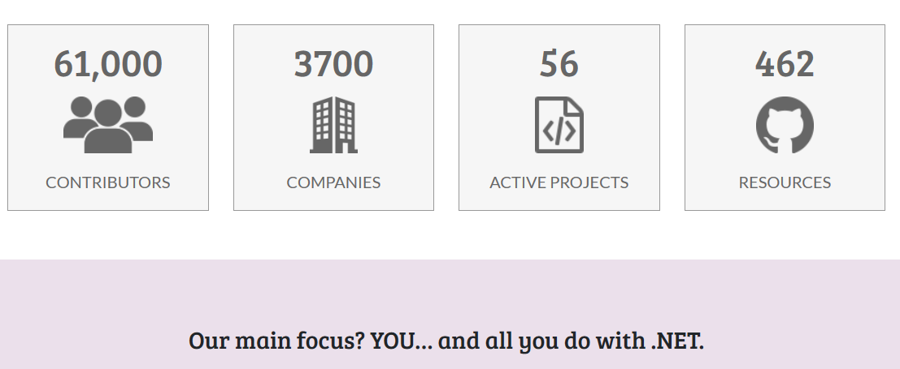
www.dotnetfoundation.org
Notes:
The ecosystem starts with you! Get involved by joining (or running!) a meetup. Contribute to projects, or just read the news. Visit www.dotnetfoundation.org
Join the foundation as a member and vote for the board.

Slide 7
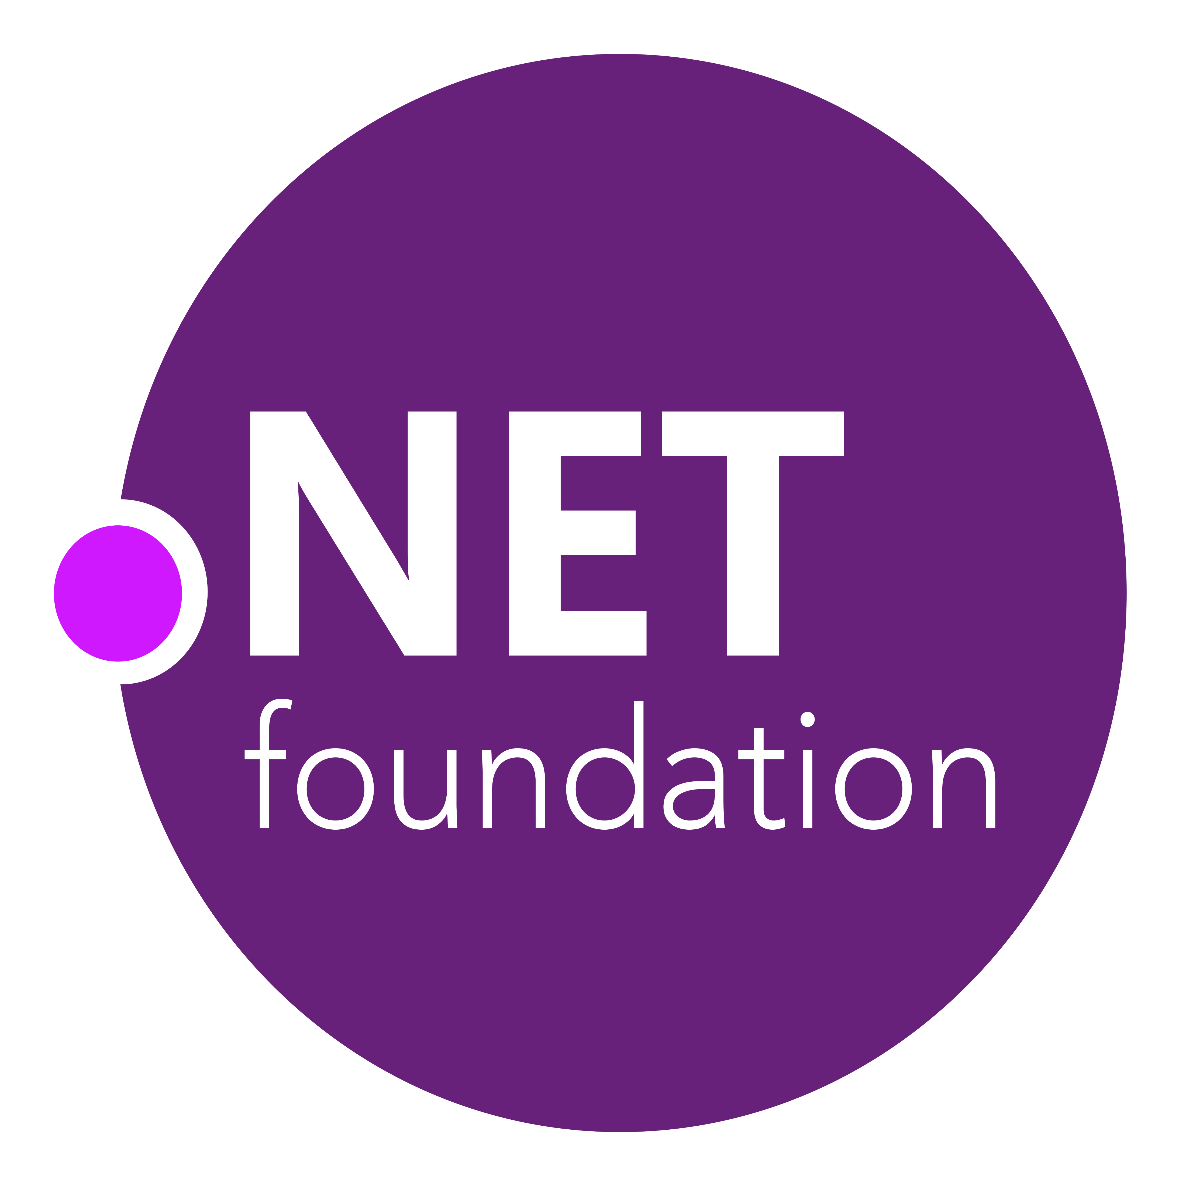

History of .NET
.NET
Aug. 2017
.NET Core 2.0 released
2001
ECMA 335 (CLI)
2008
ASP.NET MVC (web platform) open source
April 2014
.NET Compiler Platform (“Roslyn”) open source
.NET Foundation founded
Fall 2019
.NET Core 3.0
Fall 2020
.NET 5
2016
Mono project joins .NET Foundation Microsoft acquires Xamarin
2000
NET 1.0
Beta
2002
NET 1.0 for Windows released. Mono project begins
Dec. 2018
.NET Core 2.2 released
.NET Core 3.0 preview WinForms and WPF go open source
Nov. 2014
.NET Core (cross-platform) project begins
Notes:
<talk to the journey, key milestones below>
2001 Common Language Infrastructure
Dec 2001-Feb 2002.
A new platform is born. Along with HP, Intel and others, the ECMA-335 standard was created that defined a common language infrastructure to support multiple programming languages. C# and Visual Basic.NET were released and F# came later in 2007, but there are over 20 other .NET languages today. Visual Studio .NET was released and included C#, VB, C++ development all in one box. This was the first IDE that was truly integrated across multiple languages.
Mono project begins. The CLI spec gave others the ability to create their own .NET implementations. Even though Microsoft built the first .NET Framework for Windows-only, the spec was intentionally portable across OSes and chipsets. The Mono project began, spearheaded by Miguel de Icaza, with the goal to implement Microsoft's new .NET development platform on Linux and Unix-like platforms. Later, Miguel started Xamarin which focused on cross-platform, native, mobile development with C#, built upon Mono. This allows developers to use C# and .NET to build apps for iOS and Android. Unity games development also emerged from Mono.
2008.
ASP.NET MVC web development stack is released to CodePlex as open source. This was the first application development framework from Microsoft to be released as open source. The underlying runtime and compilers were still closed however.
2014.
Hell freezes over & pigs fly. Early 2014 at Microsoft’s BUILD conference, Anders Hejlsberg, the father of C#, releases the .NET Compiler Platform “Roslyn” as open source on stage. Later in November, .NET Core project begins in the open. The technology world is shocked, and the .NET community is excited. .NET Core is a new cloud-native implementation of .NET that is geared for cross-platform, hyper-scale services as well as small IoT devices. It’s meant to bring .NET into the next 15 years of computing. And the community has been extremely supportive….
2016.
Mono comes home. In early 2016, Microsoft finally acquires Xamarin and brings Miguel de Icaza into Developer Division. Mono joins the .NET foundation and is officially supported and contributed to by Microsoft. The Microsoft community officially meets the Mono community.
2017.
.NET Core 2.0 Released. Our cross platform and open source implementation of .NET finally releases to the world with unified tooling support across multiple operating systems and editors.
2018.
Winforms and WPF go open source. At Microsoft Connect 2018 we announced the open sourcing of Windows Forms and WPF desktop frameworks. We’ve seen incredible contributions and activity since. The community now has the power to guide the direction of these frameworks.
2019
.NET Core 3.0 released. .NET Core 3.0 brings Windows desktop workloads to the .NET Core runtime which will allow self contained EXEs, side-by-side installs, and faster performance.

Slide 8
.NET Framework
www.dot.net

Slide 9
What is the .NET Framework?
A Windows-based software framework by Microsoft that provides language interoperability for developing programs that run in a managed environment
ASP.NET Webforms
ASP.NET MVC
ASP.NET Web API
Winforms
WPF
WCF

Slide 10
Important acronyms
CLR – Common Language Runtime. The VM that manages .NET program execution and provides memory management, type safety, exception management, etc.
CLI – Common Language Infrastructure. Open spec for multi-language support across different architectures
CTS – Common Type System. Standard for data types and operations shared by all compliant languages
IL – Intermediate Language. .NET programs compile via language-specific compilers (C#, VB, etc) down to IL
JIT – Just-in-time compilation. The CLR uses JIT to convert IL to machine-specific instructions
BCL – Base Class Library. Built-in data types of the CLI, standard functionality such as string manipulation, file access, etc.
FCL – Framework Class Library. Builds on the BCL to provide everything else, including ASP.NET, WPF, etc.

Slide 11
.NET Core
www.dot.net

Slide 12
What is .NET Core?
A free, cross-platform, open source software framework for building many different types of applications.
Why?
Improved performance: Rebuilt from ground up to be fast and lean
More reach: Run on Windows, macOS, Linux
Flexible deployment: Can deploy framework with app, run multiple frameworks side-by-side, better container support
Open source: Leverage the development community
Faster release cadence: ability to run side-by-side allows for more frequent release of new features
Notes:
https://docs.microsoft.com/en-us/dotnet/core/about

Slide 13
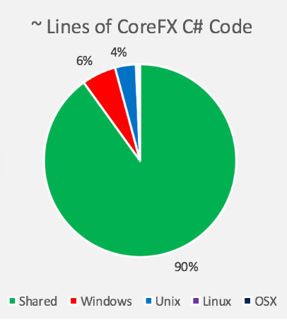
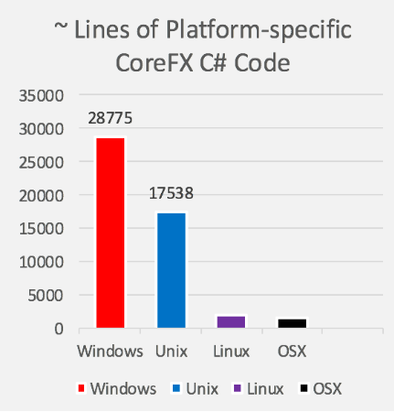
More acronyms
CoreCLR – Core CLR
CoreFX – Modular FCL
.NET CLI - .NET Core Command Line Interface. Command-line toolchain for developing .NET Core applications
global.json
RID – Runtime Identifier. Identifies target platform for an application. Examples: win10-x64, linux-arm, etc.
MetaPackage – Set of nuget packages that are meaningful together (.NET Standard, .NET Core App, ASP.NET Core) and can be installed on a machine and referenced by multiple applications
Notes:
https://docs.microsoft.com/en-us/dotnet/standard/frameworks

Slide 14
What is .NET Standard?
Formal specification of APIs intended to be available across all .NET implementations
Enables developers to produce portable libraries that are usable across .NET implementations, using this same set of APIs.
The higher the version, the more APIs are available to you.
The lower the version, the more platforms implement it.
Target the lowest version possible for maximum compatibility. Target the highest for the most functionality.
PlatformNotSupportedException for unsupported APIs
https://github.com/dotnet/standard/blob/master/docs/versions.md
Notes:
Primarily for class library developers
IL can be compiled against any .NET platform supporting the standard
https://github.com/dotnet/standard/blob/master/docs/versions.md

Slide 15
When to use?
Use .NET Framework
When you must work within a large .NET Framework code base that is not ready or not suitable to migrate
You depend on libraries that are not available on .NET Core
Use .NET Core
For everything else

Slide 16

87% contributors outside Microsoft
.NET open source momentum
61,000+ accepted PRs from community
Notes:
We’re proud of all the innovation in .NET Core and the surrounding ecosystem, but we’re also proud of its momentum in the open source community.
There are a number of open source projects that make up the .NET platform ecosystem, and it’s amazing to see the engagement. 87% of the people who contribute to the .NET platform don’t work at Microsoft.
And these open source developers have made over 61 thousand code contributions back to the platform.

Slide 17
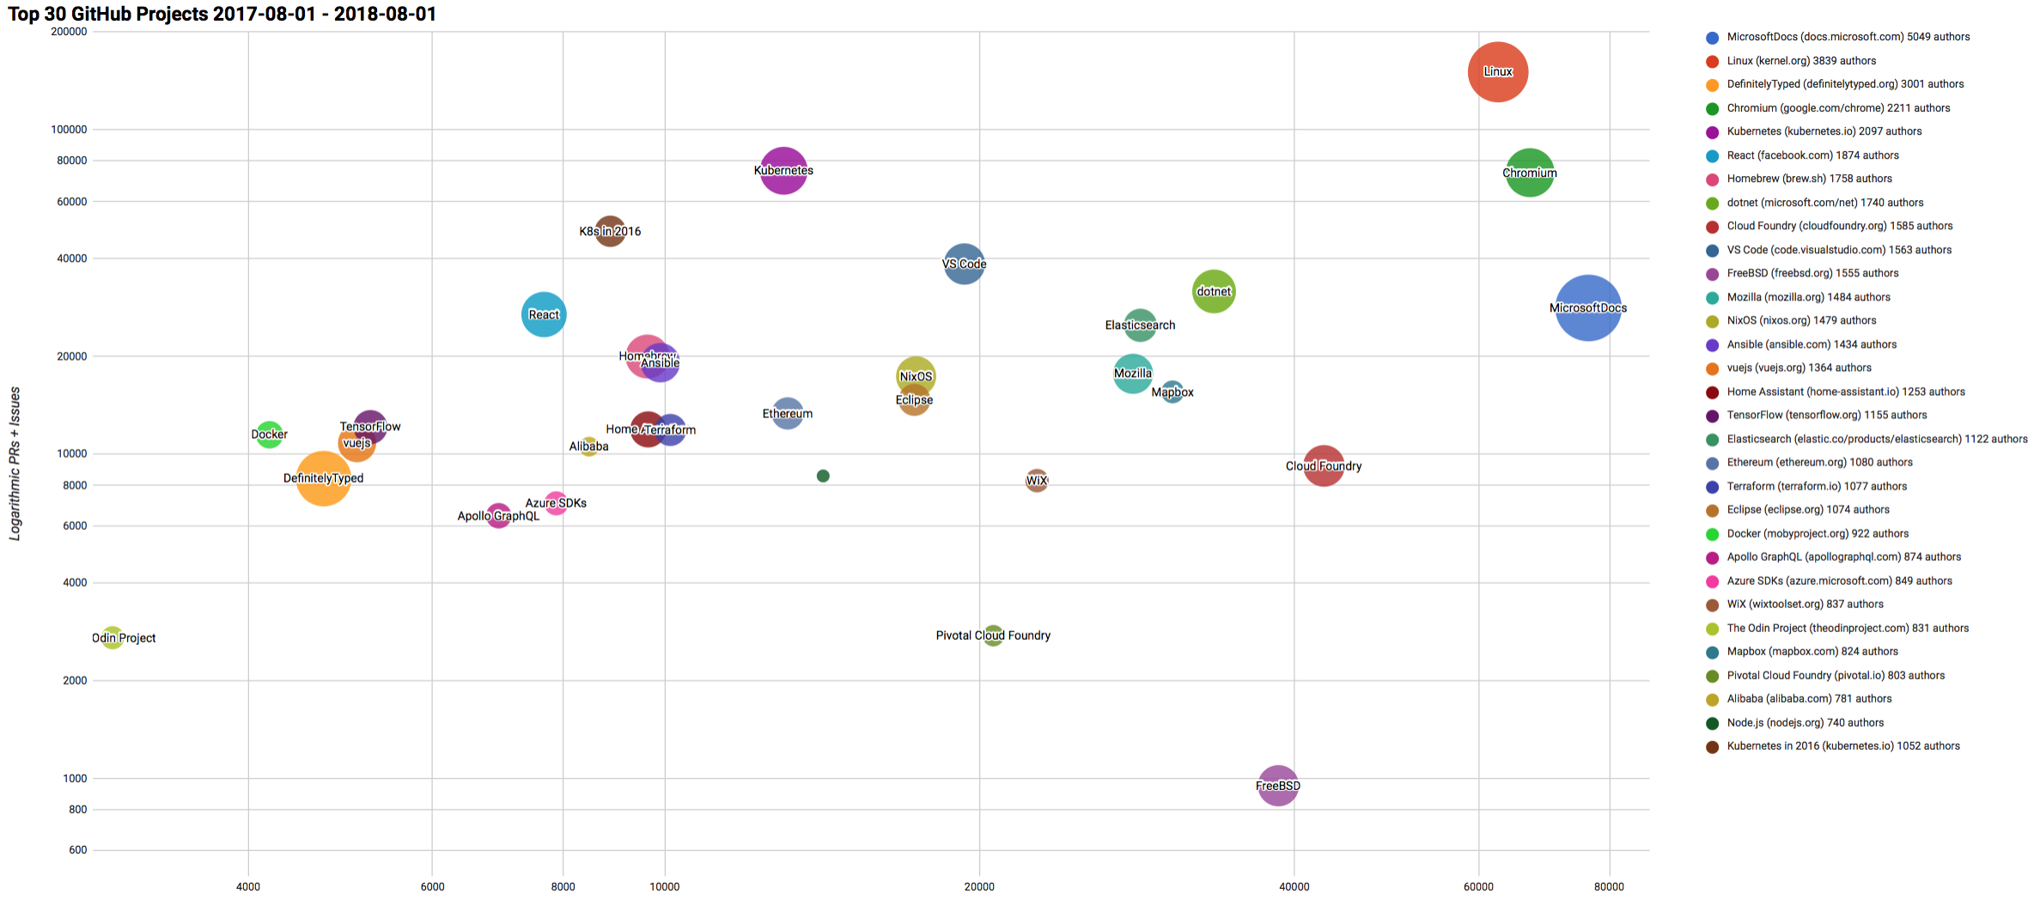

Top 30 Highest Velocity OSS Projects on GitHub
https://www.cncf.io/blog/2017/06/05/30-highest-velocity-open-source-projects/
https://raw.githubusercontent.com/cncf/velocity/master/charts/top30_20170801_20180801.png
Notes:
Jim Zemlin, Executive director of Linux foundation said “There are 10’s of millions of open source projects, invest in the ones with sustainable ecosystems”. .NET is one of those projects. CNCF tracks the top 30 highest velocity open source projects. This is a logarithmic scale to measure OSS project velocity with commits on the X axis and PRs and issues on the Y axis, with # of authors indicated by the size of the circle. The farther upper right the more activity a project has. Linux Kernel is #1, followed by Chromium, Kubernetes and Microsoft Docs. Notice .NET is the #1 application framework.

Slide 18
ASP.NET Core vs ASP.NET MVC 5
Unified framework for web UI and web API
Built-in dependency injection
Self-host or host on IIS, Nginx, etc.
Lightweight and fast
Cloud-ready environment based configuration
Razor Pages, Javascript Services, etc.
Notes:
https://www.ageofascent.com/2016/02/18/asp-net-core-exeeds-1-15-million-requests-12-6-gbps/
JavascriptServices – https://docs.microsoft.com/en-us/aspnet/core/client-side/spa-services?view=aspnetcore-2.2 - call node packages, server-side rendering, webpack dev middleware, hot module replacement
Configuration - https://docs.microsoft.com/en-us/aspnet/core/fundamentals/configuration/index?view=aspnetcore-2.2

Slide 19
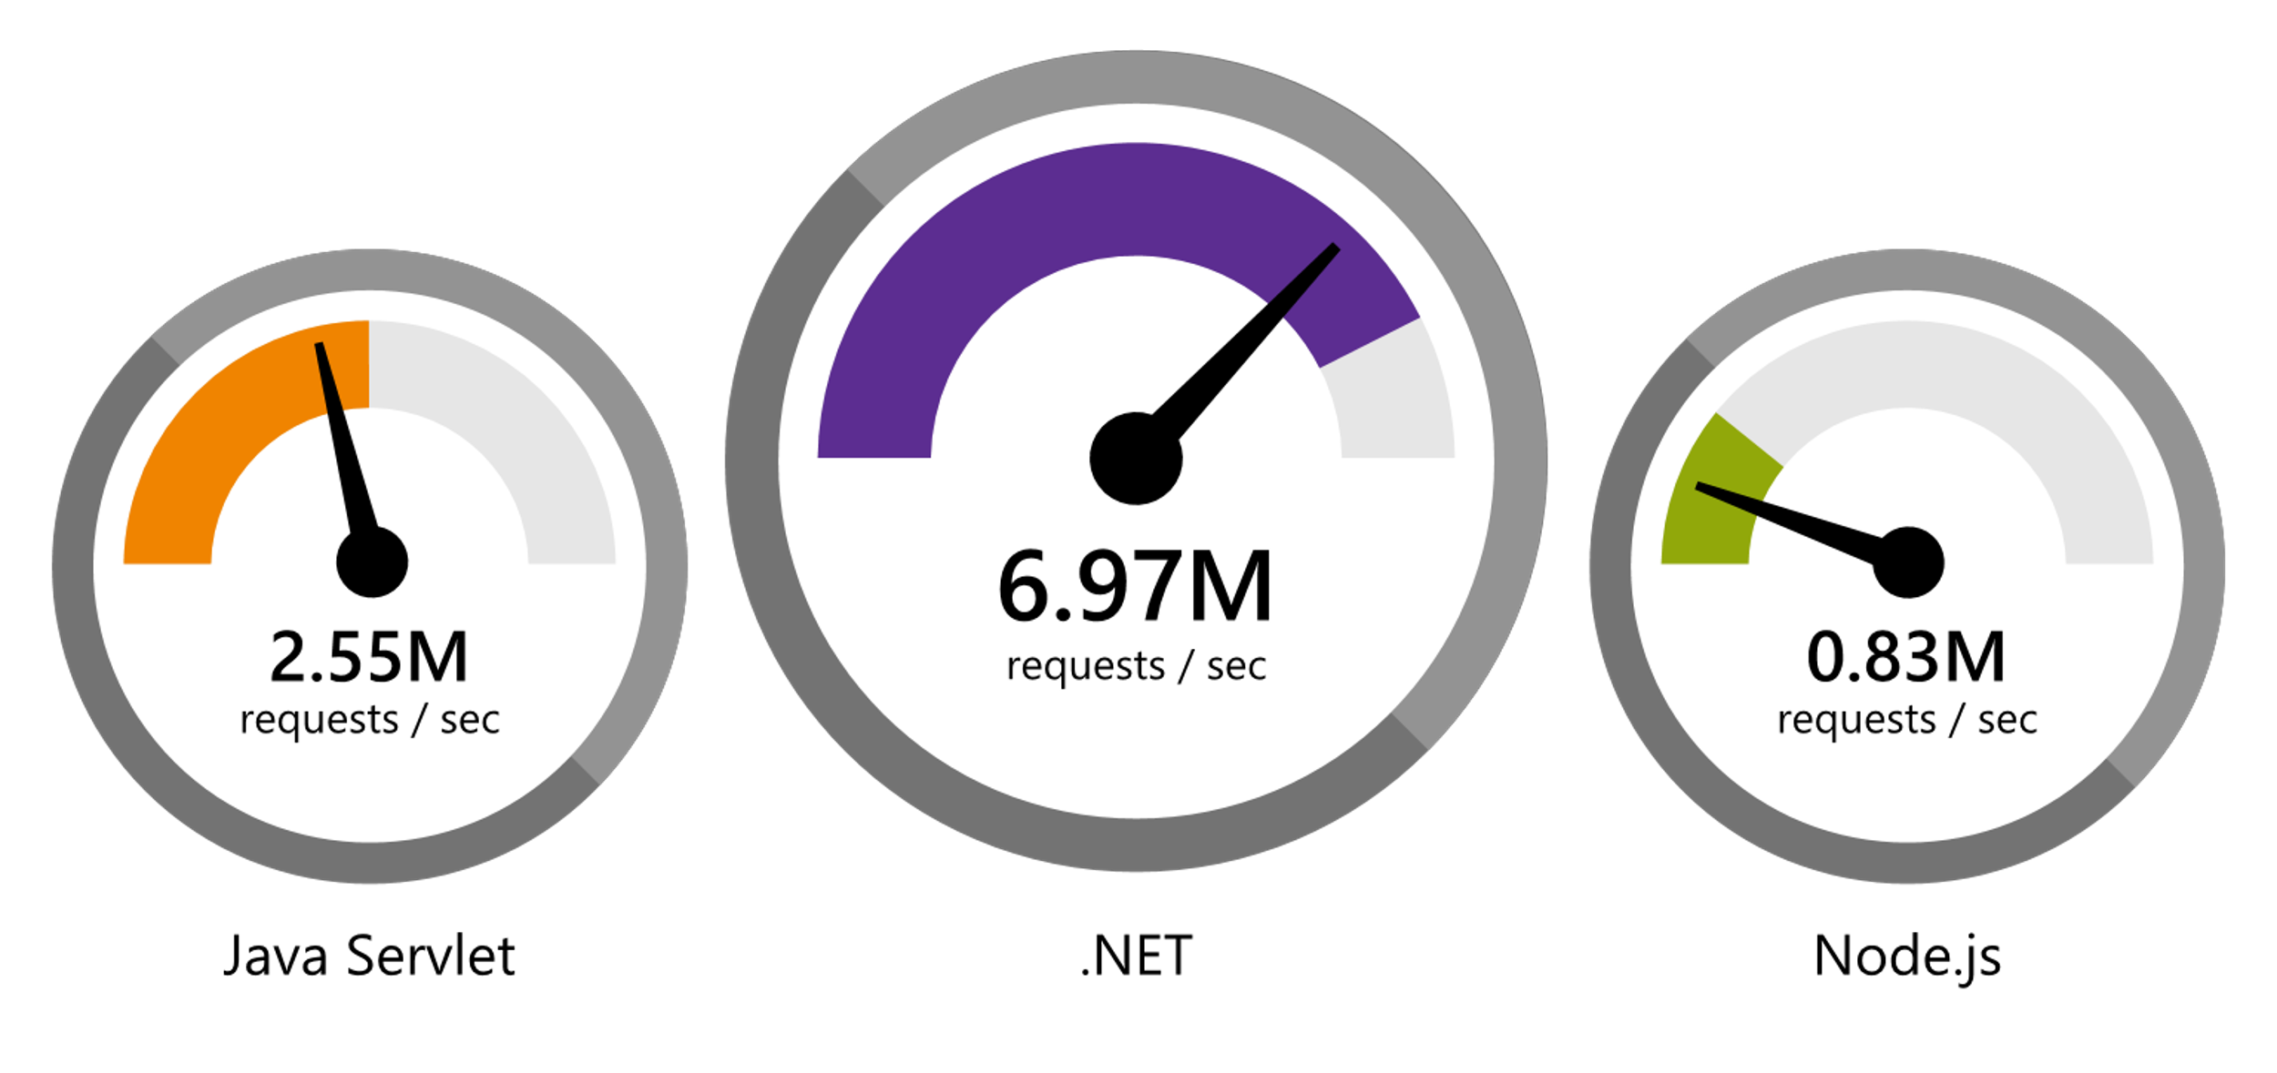
ASP.NET Core Faster than any other popular framework
Data sourced from official tests available at TechEmpower Round 16.
“Using the same-size server, we were able to go from 1,000 requests per second per node with Node.js to 20,000 requests per second with .NET Core.“ — Raygun
www.dot.net/customers
Notes:
We’ve made significant investments in the platform especially in terms of performance.
The popular TechEmpower benchmark compares web application frameworks with tasks like JSON serialization, database access, and server side template rendering - .NET performs faster than any other popular framework.
https://www.techempower.com/benchmarks/#section=data-r16&hw=ph&test=plaintext
In the latest benchmarks on raw platform performance, .NET is more than 8 times faster than Node.js

Slide 20
.NET Core 2.2 Themes
Improved Web API Development
Microservices and Azure
Continued Performance Improvements

Slide 21
.NET Core 2.2 Major Features
.NET Core
Spatial extensions for SQL Server and SQLite providers
Reverse engineering of database views
Collections of owned entities
Query tagging
ASP.NET Core
Multi-tier JIT compilation (opt-in)
SQL Connection token auth
Windows ARM32 support (Nanoserver and IoT Core)
EF Core
Template updates: Bootstrap 4, Angular 6
Web API improvements, including API security
HTTP/2
IIS in-process hosting
Health checks
Endpoint routing
SignalR Java client now available (.NET Client in 2.1)
Notes:
Tiered JIT compilation: https://devblogs.microsoft.com/dotnet/tiered-compilation-preview-in-net-core-2-1/

Slide 22
Demo: .NET Core 2.2

Slide 23
Now Available .NET Core 3.0 preview 6
www.dot.net

Slide 24
.NET Core
3
2
.NET Core 3 expands supported workloads to include Windows Desktop, IoT & AI
.NET Core is perfectly suited for the requirements of cloud-native, cross-platform workloads
WEB
CLOUD
DESKTOP
IoT
AI
.NET CORE
.NET CORE 3
LIBRARIES
INFRASTRUCTURE
RUNTIME COMPONENTS
COMPILERS
LANGUAGES
Notes:
ANIMATED SLIDE – shows progression of entire .NET platform into .NET Core specific workloads.
.NET Core is our cross-platform, open source implementation of .NET and is perfectly suited for requirements of cloud-native, cross-platform services. We’ve made significant investments in the core performance as well as the web stack so that you can easily take advantage of cloud patterns and scale.
.NET Core 3 will expand on the supported workloads to include IoT, AI and Windows Desktop.

Slide 25

.NET Core 3.0 Themes
Desktop Workloads
& UI Interop
Web App Development Productivity & Microservices
Artificial Intelligence & Machine Learning
Notes:
Tree trimming - https://www.hanselman.com/blog/MakingATinyNETCore30EntirelySelfcontainedSingleExecutable.aspx
Json libraries
.net standard 2.1
Span<T> In .NET Core 2.1 we added Span<T>, which is an array-like type that allows representing managed and unmanaged memory in a uniform way and supports slicing without copying.
ValueTask and ValueTask<T> in core2.1 could use to return results if the operation completed synchronously without having to allocate a new Task<T>. With .NET Core 2.1, we’ve improved this further, making it useful to have a corresponding non-generic ValueTask that allows reducing allocations even for cases where the operation has to be completed asynchronously, a feature that types like Socket and NetworkStream now utilize.
C# 8.0

Slide 26
Desktop Improvements
WinForms and WPF
UI Framework Enhancements
XAML Islands - WinForms & WPF can host UWP
XAML Controls – WinForms & WPF browser and media UWP controls
High DPI fixes for WinForms
Access to all the Windows 10 APIs

Slide 27
Why Windows Desktop on .NET Core?
Deployment Flexibility
Side-by-side support
Machine global or app local framework
Self-contained EXEs
Core runtime and API improvements
Performance
X
=

Slide 28


Update .NET Framework Apps
Modernize Desktop Apps with .NET Core 3
Highly compatible updates
Install .NET Core updates per your
needs
Existing App
.NET Framework 4.8
.NET Core 3
Windows-only
Windows-only
Cross-platform
Highly-compatible, targeted improvements, like last few releases
UWP
WEB
DATA
AI/ML
WPF
ASP.NET Core
EF 6
EF Core
ML.NET
Windows Forms
.NET STANDARD
.NET Framework support unchanged (supported for life of Windows)
Side-by-side support
Self-contained EXEs
XAML Islands - WinForms & WPF apps can host UWP controls
Full access to Windows 10 APIs
FEATURES IN BOTH FXs
Notes:
.NET Framework will continue with highly-compatible targeted improvements like the last few releases and support will remain unchanged. You will be able to retarget existing apps to 4.8 and gain these improvements.
When you’re ready to move to .NET Core 3 (to take advantage of SxS install, interop between desktop app frameworks, and .NET Core performance) you can retarget and rebuild your apps to .NET Core.

Slide 29
ML.NET
Machine Learning framework made for .NET developers
Build-your-own
Build your own custom models by writing C# or F# code
Developer focused
ML.NET provides just the right amount of productivity and control
Extensible
Tap into other machine learning toolkits with the rich extensibility model like TensorFlow
Proven
ML.NET has been used internally in products like Office and Bing for years
Open source and Cross-platform
Runs on Windows, macOS and Linux and developed in the open on GitHub
https://github.com/dotnet/machinelearning
Notes:
ML.NET is used to develop and integrate custom machine learning models into .NET apps of any type - web, mobile, desktop, gaming, and IoT.
ML.NET is developer focused which means we are going to optimize for common developer scenarios (like recommendation, sentiment analysis)
ML.NET is based upon a decade of internal goodness
ML.NET is open source and cross-platform

Slide 30
A few things you can do with ML.NET …
Sentiment Analysis
Forecasting
Issue Classification
Predictive maintenance
Image classification
Recommendations
Object detection
Customer segmentation
And more! Samples @ https://github.com/dotnet/machinelearning-samples

Slide 31

Web Productivity with Razor Components
Build client-side Web UI in .NET
You don’t need to know Angular, React, Vue, etc.
Take advantage of stability and consistency of .NET
Runs in all browsers
Strongly typed on client and server
Share C# code with the client and the server
Blazor implements .NET Standard 2.0 – PlatformNotSupportedException for unsupported APIs
Web Assembly (Experimental)
Native performance
Requires no plugin or code transpilation
Or run server-side
SignalR used to update DOM
Full-stack web development with C#
Notes:
https://docs.microsoft.com/en-us/aspnet/core/blazor/hosting-models?view=aspnetcore-3.0

Slide 32
Demo: .NET Core 3.0
Notes:
5min

Slide 33
No more Framework ports after .NET Core 3
Web Forms
Blazor or Razor Pages recommended as closest programming models
WCF
ASP.NET Web API
gRPC – open source high performing RPC framework
CoreWCF – ongoing open-source project to port much of WCF to .NET Core
WF
CoreWF – ongoing open-source project to port WF to .NET Core
Notes:
https://devblogs.microsoft.com/dotnet/net-core-is-the-future-of-net/
https://www.telerik.com/blogs/razor-pages-the-natural-successor-to-web-forms
https://github.com/CoreWCF/CoreWCF
https://github.com/UiPath/corewf

Slide 34
The Future of .NET Framework
.NET Framework is ending
Why? To stop breaking your apps!
Billions of installs. Getting much harder to release major features without compatibility issues
Can innovate much faster with .NET Core because of its side-by-side nature
Microsoft will continue to update
Many major product lines within Microsoft depend on .NET Framework
Microsoft will continue to update .NET Framework for years to come. High-compat features only.
Things like… new security protocols, bug fixes, Windows features, etc.
No changes to support policy
Support for 10 years (5 mainstream+5 custom) per Windows support policy for each release
.NET Framework will remain a Windows component and service policy is the same as Windows
Recommend new development on .NET Core

Slide 35
Coming in 2020
.NET 5
www.dot.net

Slide 36
.NET 5
One .NET to target all platforms
Unify .NET Core, .NET Standard, and Xamarin
Windows, Linux, macOS, iOS, Android, tvOS, watchOS, WebAssembly, etc.
Single runtime and framework
Xamarin and Blazor will use CoreFX; AOT compilation option for CoreFX
Choose runtime “experience” – Core CLR vs. Mono
Notes:
.NET 5 is .NET Core vNext
https://devblogs.microsoft.com/dotnet/introducing-net-5/

Slide 37
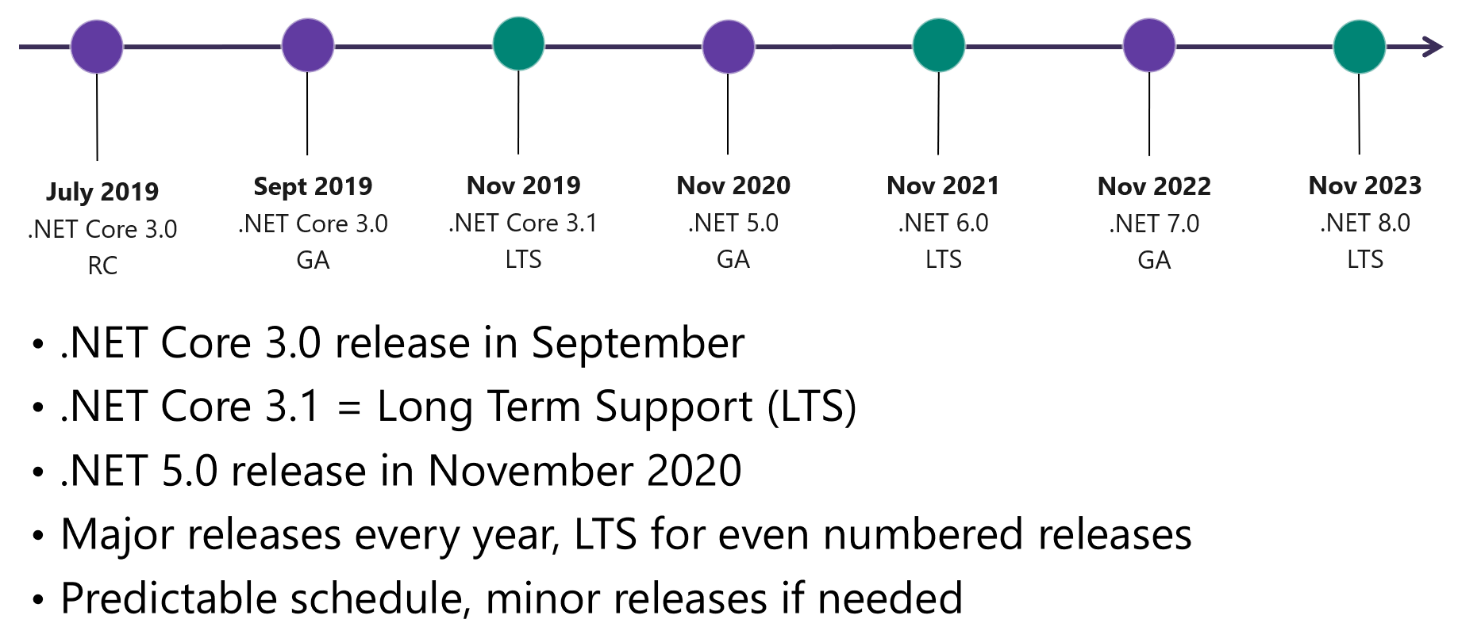
.NET 5 Release Schedule
https://github.com/dotnet/core/blob/master/roadmap.md

Slide 38
Questions?
DESKTOP
WEB
CLOUD
MOBILE
GAMING
IoT
AI
.NET
www.dot.net

